Slide 1
COMPUTER VISION WITH ULTRASONOGRAPHY IMAGES ON PREGNANCY STAGES IDENTIFICATION WITH DEEP LEARNING
Jui Saha
ID:201-15-14115
Department of CSE
Daffodil International University
Sharun Akter Khushbu
Lecturer (Senior Scale)
Department of CSE
Daffodil International University
Saturday, 7 January 2023

Slide 2
Table of Content
Objective | Experimental Result & Analysis
Abstract | Limitation, Future Work & Conclusion
Data Collection | Necessary Links
Methodology | References

Slide 3
Objective
Pregnancy stage identification
At least 95% accuracy
Model comparison
Collaboration with medical professionals

Slide 4
Abstract

Slide 5
Data collection
Process/collection
Approval of the director.
Data Collected form
City Dental Medical College
Selina Memorial Hospital
Medical Pathology
New Sheba
Use mobile camera
738
Figure 1:Amount of Raw Data
5

Slide 6
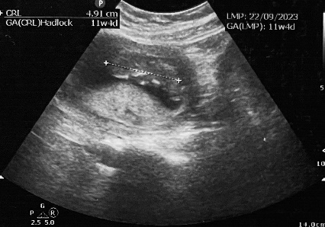
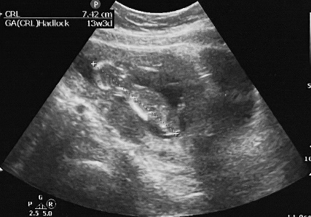
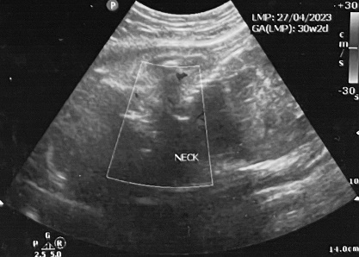
Sample of the Dataset
Figure 2: Sample of the Dataset

Slide 7
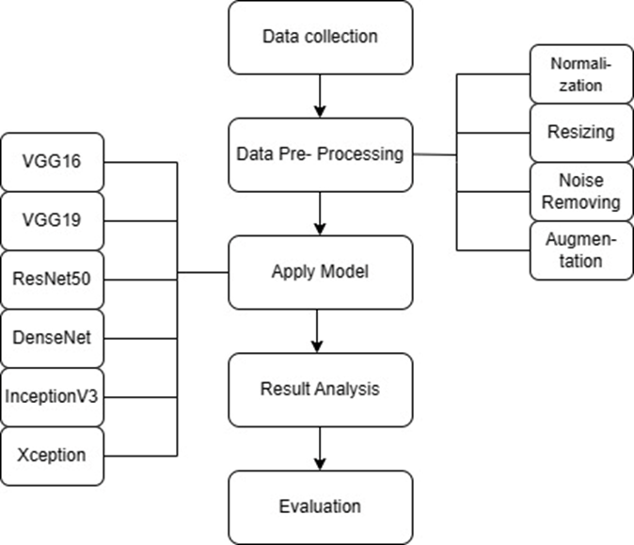
Methodology
Figure 3: Methodology Diagram
7

Slide 8
Preprocessing Techniques
Normalization
Resizing
Noise Removing
Augmentation
Figure 3: Step of Preprocessing Techniques
8

Slide 9
Apply Model

Slide 10
Experimental Result & Analysis
Test data usage rate |  | Testing | Specification | Sensitivity
Algorithms Accuracy | VGG16 | 0.93 | 0.97 | 0.94
 | VGG19 | 0.96 | 0.98 | 0.96
 | ResNet50 | 0.95 | 0.60 | 0.95
 | DenseNet | 0.77 | 0.89 | 0.78
 | InceptionV3 | 0.61 | 0.80 | 0.59
 | Xception | 0.75 | 0.88 | 0.75
Table 1: Experimental Result Accuracy

Slide 11
Result Analysis
 | Configuration No | Batch Size | Accuracy | Miss Class | Findings
VGG19 | 1 | 16 | 90.97% | 9.03 | Intermediate Accuracy
 | 2 | 32 | 96.25% | 3.75 | Highest Accuracy
 | 3 | 64 | 93.75 | 6.25 | Modest Accuracy
 | 4 | 128 | 84.38 | 15.62 | Lowest Accuracy
Table 2: Different Batch Size of VGG19

Slide 12
Evaluation
Figure 4: Evaluation Models

Slide 13
Limitation

Slide 14
Future Scope / Work
Increase the dataset.
Used Hybrid model.
Clinical validation of models.
Advise the patient.

Slide 15
Conclusion
Automate pregnancy stage identification.
Balanced with 450 samples for each class.
Applied essential techniques.
Tested six for trimester classification.
VGG19 with 0.96 accuracy.
Critical for medical research and prenatal care.

Slide 16
Necessary Links
Website link (Click)
Coding link (Click)
Coding Video link (Click)

Slide 17
References
Xue, H., Yu, W., Liu, Z., & Liu, P. (2023). Early Pregnancy Fetal Facial Ultrasound Standard Plane‐Assisted Recognition Algorithm. Journal of Ultrasound in Medicine, 42(8), 1859-1880.
Li, X., Wu, J., Hou, R., Zhou, Z., Duan, C., Liu, P., ... & Zhu, C. (2024). Analyzing the pregnancy status of giant pandas with hierarchical behavioral information. Expert Systems with Applications, 237, 121462.
He, H., Liu, R., Zhou, X., Zhang, Y., Yu, B., Xu, Z., & Huang, H. (2022). B-Ultrasound Image Analysis of Intrauterine Pregnancy Residues after Mid-Term Pregnancy Based on Smart Medical Big Data. Journal of Healthcare Engineering, 2022.
Lin, Q., Zhou, Y., Shi, S., Zhang, Y., Yin, S., Liu, X., ... & Dong, F. (2022). How much can AI see in early pregnancy: A multi‐center study of fetus head characterization in week 10–14 in ultrasound using deep learning. Computer Methods and Programs in Biomedicine, 226, 107170.
Gupta, K., Balyan, K., Lamba, B., Puri, M., Sengupta, D., & Kumar, M. (2022). Ultrasound placental image texture analysis using artificial intelligence to predict hypertension in pregnancy. The Journal of Maternal-Fetal & Neonatal Medicine, 35(25), 5587-5594.

Slide 18
References
Mu, Y., Feng, K., Yang, Y., & Wang, J. (2018). Applying deep learning for adverse pregnancy outcome detection with pre-pregnancy health data. In MATEC Web of Conferences (Vol. 189, p. 10014). EDP Sciences.
Kim, B., Kim, K. C., Park, Y., Kwon, J. Y., Jang, J., & Seo, J. K. (2018). Machine-learning-based automatic identification of fetal abdominal circumference from ultrasound images. Physiological measurement, 39(10), 105007.
Xie, H. N., Wang, N., He, M., Zhang, L. H., Cai, H. M., Xian, J. B., ... & Yang, Y. Z. (2020). Using deep‐learning algorithms to classify fetal brain ultrasound images as normal or abnormal. Ultrasound in Obstetrics & Gynecology, 56(4), 579-587.
Looney, P., Stevenson, G. N., Nicolaides, K. H., Plasencia, W., Molloholli, M., Natsis, S., & Collins, S. L. (2017, April). Automatic 3D ultrasound segmentation of the first trimester placenta using deep learning. In 2017 IEEE 14th International Symposium on Biomedical Imaging (ISBI 2017) (pp. 279-282). IEEE.
Richter, J. E. (2005). The management of heartburn in pregnancy. Alimentary pharmacology & therapeutics, 22(9), 749-757.

Slide 19
Thank you

